Slide 1
Data Mining with IPython Notebook & D3.js.
By Intellij System Solution Sdn. Bhd.

Slide 2
Applications

Slide 3
What is the course about
Data mining
Using data to make predictions
Ipython notebook
IPython Notebook is a web-based interactive computational environment for creating IPython notebooks. An IPython notebook is a JSON document containing an ordered list of input/output cells which can contain code, text, mathematics, plots and rich media.
D3.js
JavaScript library for producing dynamic, interactive data visualizations in web browsers. It makes use of the widely implemented SVG, HTML5, and CSS standards. It is the successor to the earlier Protovis framework.

Slide 4
Prerequisites for this course
Github accounts.
Willingness and perseverance.

Slide 5
Setup Environment for IPython Notebook
Install python 2.7.
$ pip install ipython
$ iptest

Slide 6
UI Components IPython Notebook
Notebook Dashboard
Notebook Editor
Edit Mode and Notebook Editor
File Editor

Slide 7
Notebook Dashboard

Slide 8
Notebook Editor

Slide 9
Edit Mode and Notebook Editor

Slide 10
File Editor

Slide 11
Demo
http://bit.ly/2rNIZLY

Slide 12
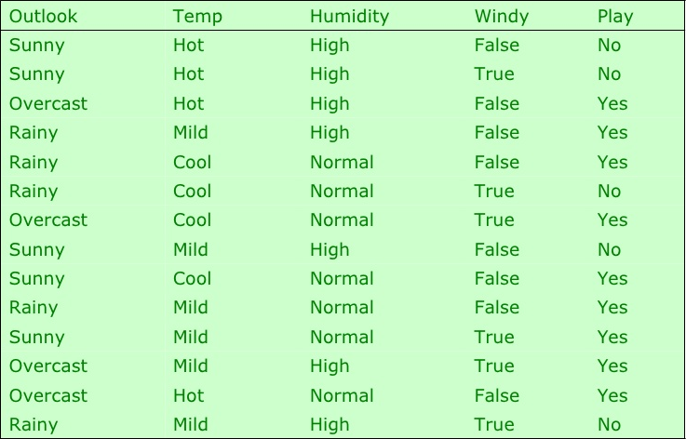
Exploring datasets
Notes:
Attributes
Class

Slide 13
Attributes
Attribute (or dimensions, features, variables): a data field, representing a characteristic or feature of a data object.
E.g., customer _ID, name, address
Types:
Nominal
Binary
Numeric: quantitative
Interval-scaled
Ratio-scaled

Slide 14
Attribute Types
Nominal: categories, states, or “names of things”
Hair_color = {auburn, black, blond, brown, grey, red, white}
marital status, occupation, ID numbers, zip codes
Binary
Nominal attribute with only 2 states (0 and 1)
Symmetric binary: both outcomes equally important
e.g., gender
Asymmetric binary: outcomes not equally important.
e.g., medical test (positive vs. negative)
Convention: assign 1 to most important outcome (e.g., HIV positive)
Ordinal
Values have a meaningful order (ranking) but magnitude between successive values is not known.
Size = {small, medium, large}, grades, army rankings

Slide 15
Numeric Attribute Types
Quantity (integer or real-valued)
Interval
Measured on a scale of equal-sized units
Values have order
E.g., temperature in C˚or F˚, calendar dates
No true zero-point
Ratio
Inherent zero-point
We can speak of values as being an order of magnitude larger than the unit of measurement (10 K˚ is twice as high as 5 K˚).
e.g., temperature in Kelvin, length, counts, monetary quantities

Slide 16
Discrete vs. Continuous Attributes
Discrete Attribute
Has only a finite or countably infinite set of values
E.g., zip codes, profession, or the set of words in a collection of documents
Sometimes, represented as integer variables
Note: Binary attributes are a special case of discrete attributes
Continuous Attribute
Has real numbers as attribute values
E.g., temperature, height, or weight
Practically, real values can only be measured and represented using a finite number of digits
Continuous attributes are typically represented as floating-point variables

Slide 17
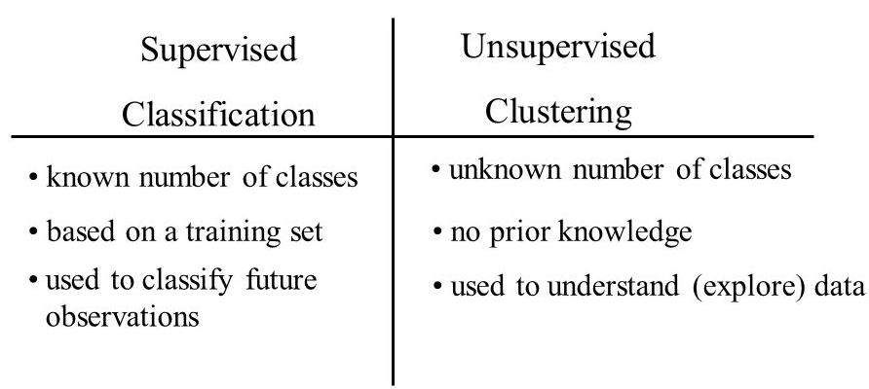
Comparison Supervised and Unsupervised Learning

Slide 18
Classifier
Naïve Bayes Classifier Algorithm.
K Means Clustering Algorithm.
Support Vector Machine Algorithm.
Apriori Algorithm.
Linear Regression.
Logistic Regression.
Artificial Neural Networks.
Random Forests.

Slide 19
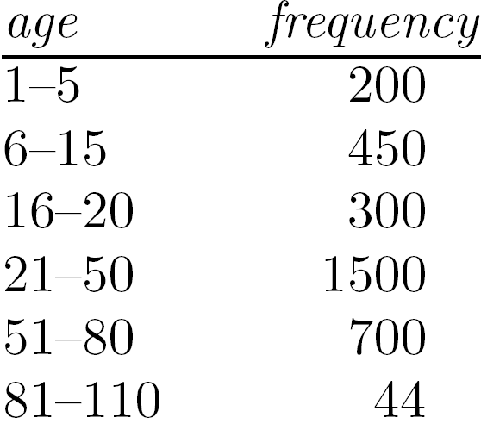
Measuring the Central Tendency
Mean (algebraic measure) (sample vs. population):
Note: n is sample size and N is population size.
Weighted arithmetic mean:
Trimmed mean: chopping extreme values
Median:
Middle value if odd number of values, or average of the middle two values otherwise
Estimated by interpolation (for grouped data):
Mode
Value that occurs most frequently in the data
Unimodal, bimodal, trimodal
Empirical formula:

Slide 20
Measuring the Dispersion of Data
Variance and standard deviation (sample: s, population: σ)
Variance: (algebraic, scalable computation)
Standard deviation s (or σ) is the square root of variance s² ⁽or σ²⁾

Slide 21
Detailed Accuracy By Class
TP Rate
FP Rate
Precision & Recall
F-Measure
ROC Area
http://bit.ly/2qj5BHP
Confusion Matrix
http://bit.ly/2qn1vdN
http://bit.ly/2piTCZv
http://bit.ly/2qmYdqU
http://bit.ly/1In2v72
http://bit.ly/25JMSDF

Slide 22
Building a classifier
Lab 1

Slide 23
Data treatment
Variable Identification
Univariate Analysis
Bivariate Analysis
Missing Values Imputation
Outliers Treatment
Variable transformation
Variable / Feature creation

Slide 24
Data treatment
Lab 2

Slide 25
Visualizing your data

Slide 26
Visualizing your data
Lab 3

Slide 27
Training & Testing
Notes:
Split from 1 dataset (ex 80:20)

Slide 28
Training & Testing
Lab 4

Slide 29
Cross Validation

Slide 30
Cross Validation
Lab 5

Slide 31
Random Forest
What is Random Forest?
How does it work?
Advantages of Random Forest.
Disadvantages of Random Forest.

Slide 32
Naïve Bayes Classifier Algorithm
What is Naïve Bayes Classifier Algorithm?
How does it work?
Advantages of Naïve Bayes Classifier Algorithm.
Disadvantages of Naïve Bayes Classifier Algorithm.

Slide 33
K-Nearest Neighbors algorithm
What is K-Nearest Neighbors algorithm?
How does it work?
Advantages of K-Nearest Neighbors Algorithm.
Disadvantages of K-Nearest Neighbors Algorithm.

Slide 34
Linear Regression
What is Linear Regression?
How does it work?
Advantages of Linear Regression.
Disadvantages of Linear Regression.

Slide 35
Logistic Regression
What is Logistic Regression?
How does it work?
Advantages of Logistic Regression.
Disadvantages of Logistic Regression.

Slide 36
Support Vector Machine
What is Support Vector Machine?
How does it work?
Advantages of Support Vector Machine.
Disadvantages of Support Vector Machine.

Slide 38
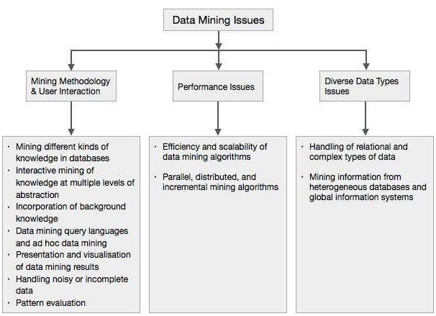
Top Challenges

Slide 39
Data Mining Ethics
Privacy
Trust Between Customers and Business

Slide 40
Topics we not covered in this course
Natural Language Processing
Image Processing

Slide 41
Questions?

Slide 42
Contact Us
Email: nurdin@intellij.my
Phone: +6 011 2625 2058
Address: E-28-1, Jalan Multimedia 7/AG City Park, i-City 40000 Shah Alam, Selangor Malaysia.

